Slide 1
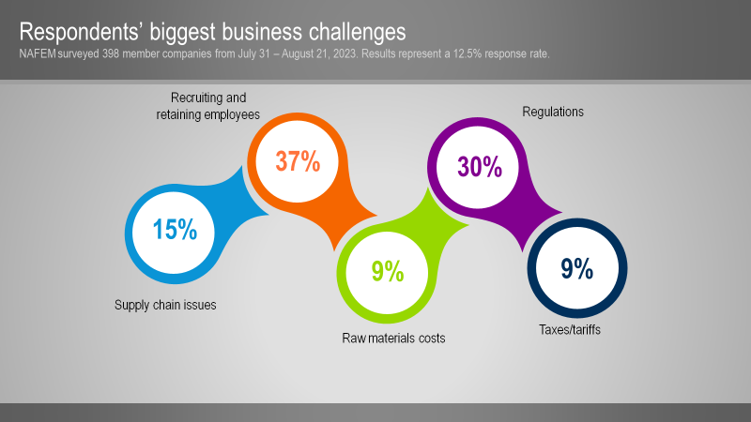

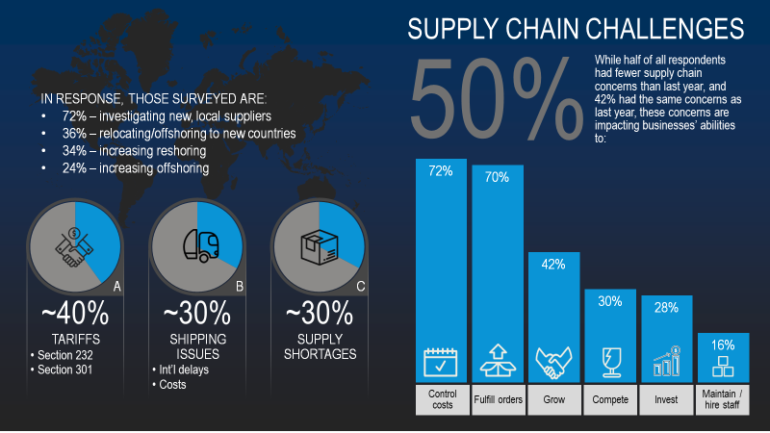
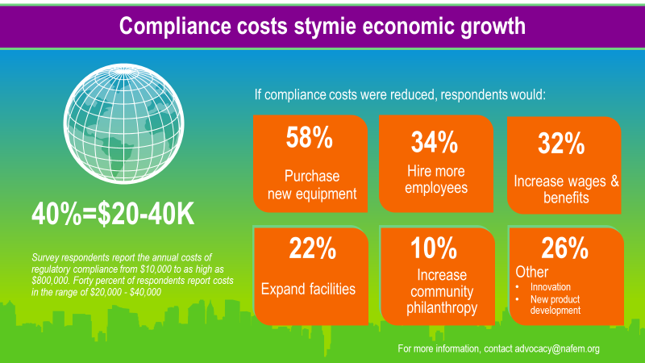
PowerPoint Infographics Sampler
October 2023
SUPPLY
CHAIN AND BUSINESS CHALLENGE
SURVEY

